Slide 1
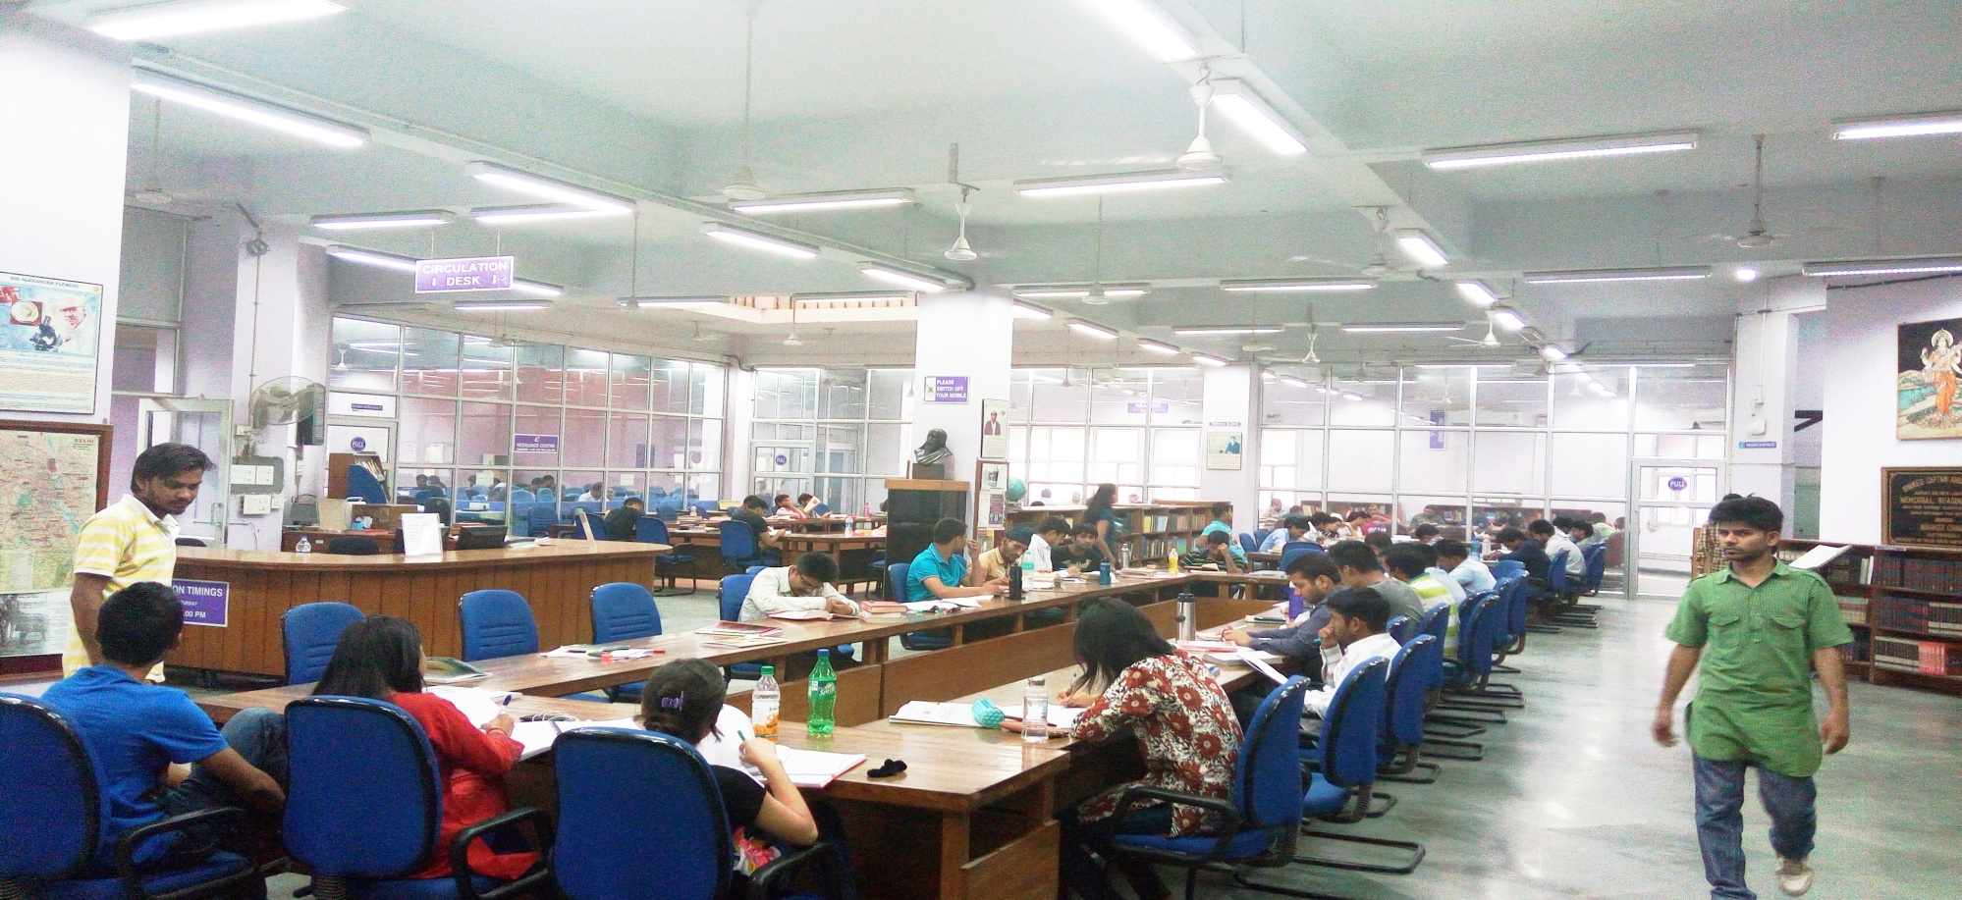
SOUTH CAMPUS LIBRARY:
Information Brochure
University of Delhi South Campus
Benito Juarez Road, New Delhi-110021

Slide 2
LIBRARY PROFILE
  Established in 1973 in South Extension to facilitate access for those residing in South Delhi.
  Moved to its present location on Benito Juarez Road, near Dhaula Kuan, in 1984.
  Housed in a four storey separate building, in beautiful surroundings on an elevated site at the center of the Campus and offers a congenial environment for study and research.

Slide 3
LIBRARY PROFILE (contd)
Only Library in DULS which serves all 3 branches of teaching, learning & Research i.e. Sciences, Social Science and Humanities.
Caters to 19 Departments and 27 Colleges located in South Delhi.

Slide 4
VISION
Promote Teaching , learning , discovery and Research by acquiring, developing and delivering knowledge resources.
Provide access to and preserve materials to meet the needs of present and future generations of students and scholars and a continuously strives to enhance discovery, access, and use of the collections.
Explore and implement innovative technologies and services to deliver information and scholarly resources conveniently to users anytime/anyplace.
Provide well-equipped and vibrant physical spaces where students can pursue independent learning and discovery outside the classroom.

Slide 5
BEST PRACTICES
Recognize users as our primary focus.
Innovative and Proactive.
Leveraging ICTs in Delivery of Services
Regular Feedback/Participation of Stakeholders
Extensive Promotion of Library Usage through ILPs
Keeping current through LIS literature

Slide 6
DISTINCT SERVICES/ AREAS
Electro Magnetic Security System
Security & Surveillance
Facilities for Differently–Abled

Slide 7
SWOC
Strengths : Fully Automated , Secure, Signage , Robust Infrastructure, Updated Collections, Light Reading Section, Rare Book Section
Weakness : Lack of Permanent Staff, Space Constraint.
Opportunities: Digitisation , Research Promotion
Challenges : To increase footfall, Optimum utilisation of Resources, Transformation into a “ Happening Place” through Extension & Outreach Services

Slide 8
LIBRARY TIMINGS
The Library remains open from 9:00 A.M. to 11:00 P.M. from Monday to Saturday & on Sunday 9:00 A.M. to 5:30 P.M.
Post 7:30 PM, only Reading Facilities are available.

Slide 9
LIBRARY LAYOUT
Library provides reading facilities to more than 300 students in Air-Conditioned Environment with 5 reading halls interspersed with collection on all the floors.

Slide 10
GROUND FLOOR
EMS Based Check point
Membership Section
Circulation Section
Librarian’s Office
Reference Section
Acquisition Section
E-Resource Center
OPAC
Periodical Section
Photocopying Facility
Light Reading Section
Faculty Lounge
Reading Halls I, II, III

Slide 11
FIRST FLOOR
(Technical Processing Section)
HUMANITIES
OPAC
Stack Area
English
Sanskrit
Hindi
Hindi-Journalism
Linguistic
Religion
Philosophy
Fine Arts
SOCIAL SCIENCES
OPAC
Stack Area
Social Science
History
Business Economics
Finance
Political Science
Sociology
Reading Hall -IV

Slide 12
SECOND FLOOR
OPAC
Bound Periodicals
Close Section
Reading Hall-V
Help Desk
Stack Area :
Mathematics
Computer Science
Electronic Science
Bio-Chemistry
Bio-Physics
Genetics
Microbiology
Bio-Technology
Plant Molecular Biology
Education
Psychology

Slide 13
THIRD FLOOR
IT PARK

Slide 14
LIBRARY GOVERNANCE
Part of DULS Federal Structure
Reporting to Director, UDSC through a 19 Member Library Committee
Reporting to University Librarian on Policy/ Planning/HR Issues

Slide 15
LIBRARY RESOURCES

Slide 16
Financial Resources:
FY -2018-19
Books - Rs. 65,00, 000
Print Journals - Rs. 55,00,000
Office Expenses - Rs. 3,79,000
Library Expanses - Rs. 83,000
Repair & Maintenance - Rs. 43,000
Seasonal Staff - Rs. 1,50,000
Overtime Allowance - Rs. 95,000
Total Rs.1,27,50,000

Slide 17
Finanacial Resources
2013-2014 - 2018-2019
Budget Head | 2013-14 | 2014-15 | 2015-16 | 2016-17 | 2017-18 | 2018-19
Books | 4895000 | 4895000 | 4895000 | 6395000 | 6500000 | 6500000
Journals & Periodicals | 4800000 | 5250000 | 5250000 | 5250000 | 5500000 | 5500000
Office Expenses | 379000 | 379000 | 379000 | 379000 | 379000 | 379000
Other Library Expenses | 83000 | 83000 | 83000 | 83000 | 120000 | 120000
Other Repair & maintenance | 43000 | 43000 | 43000 | 43000 | 60000 | 60000
Entertainment expenses | 2000 | 2000 | 2000 | 3000 | 3000 | 3000
Total | 10202000 | 10652000 | 10652000 | 12153000 | 12562000 | 12562000

Slide 18
Financial Resources
2013-2014 - 2018-2019

Slide 19
HUMAN RESOURCES
Deputy Librarian
Assistant Librarian
Prof. Assistant
Semi-Professional Assistant
Stenographer
JACT
MTS
Cleaner, Farash, Machine Operator
TOTAL
1
1
2
4
1
1
11
3
24

Slide 20
PRINT RESOURCES
Books - 1, 49000
Current Journals - 158
Bound Volumes - 15,000
Research Reports - 600
CDs -700
Newspapers -16
------------------------------------------------------
Collection-Both Classic & Contemporary-Research|Rare & Light Reading Sections

Slide 21
Collection Growth:
2012-2013 to 2017-2018
 | 2012-13 | 2013-14 | 2014-15 | 2015-16 | 2016-17 | 2017-18
New Books | 2309 | 2369 | 1990 | 2092 | 2657 | 2498
Total Books 134198 | 136507 | 138876 | 140866 | 142958 | 145615 | 148113
New Periodicals | 602 | 560 | 514 | 410 |  | 875
Total Periodicals 12489 | 13091 | 13651 | 14165 | 14575 | 14575 | 15540

Slide 22
ONLINE RESOURCES
Access to nearly 50 Electronic Databases:
Categories: Reference |Citation |Financial & Statistical | Full-Text Scholarly Journals |Theses& Dissertations
Science |Applied & Life Sciences|Social Science| Arts& Humanities | Legal Studies|

Slide 23
Members’ Privileges
S. No. | Category | No. of Books | No. of Days
1. | P.G. Students (South Campus) | 4 | 7
2. | P.G. Students (College) | 2 | 7
3. | P.G. Diploma (Journalism) | 3 | 7
4. | P.G. Certificate (Journalism) | 2 | 7
5. | Ph.D/M. Phil | 6 | 14
6. | Faculty Members (South Campus) | 15 | 14
7. | Faculty Members (College) | 6 | 14
8. | Faculty Members (Co-operative) | 4 | 14
A late fine of Rs. 1/- per day is charged for books returned after due date.

Slide 24
LIBRARY FACILITIES
Fully Automated-IT Driven-Secure-Learning Resource Centre
First Library of DULS to have been automated in year 2008 with a website
First Library to be bar-coded and adopting Single Card
First Library which adopted Electro-Magnetic Security System
First Library to have Laptop Based Lab
First Library to introduce Scanning & Plagiarism Checking Services
Extensive CCT V Surveillance-Air-Conditioning Environment
Modular Furniture -with Laptop Facilities
Faculty Lounge
Facilities for Differently –Abled/ Lift/Toilet/Braille
Clean/Filtered/RO Water

Slide 25
LIBRARY USAGE
More 300 students visit Library every day
Most of the reading halls remain full
Active demand for extending library hours
300-400 books issued during peak hours
50 Seater E-Resources Centre is heavily used
Plagiarism Checking Services-Most sought after-Nearly 15
cases attended each day
Scanning Services –quite popular
DELNET based Services- Lot of books borrowed from other Libraries
Customised Info Services –Research Support- Provided regularly
Digital Library Services –In-house reference material used extensively in Political Science, Psychology, and Economics
Periodical Section used satisfactorily.
Information Literacy Services held Regularly

Slide 26
LIBRARY SERVICES
Acquisition of books, Journals , Magazines , Newspapers,
Lending of Documents,
Online Catalogue Search
Reference Services-Help Desk at Each Floor
Access to E-Resources
Plagiarism Checking Services
Scanning Services
DELNET based Services
Orientation & Information Literacy Programmes
Customised Info Services –Research Support
Digital Library Services –In-house reference material
Photocopy Services

Slide 27
Some Vital Statistics -FY 2017-2018
Library Area | 4141.52 Sq.
Total Library Budget | Rs. 1,27,50,000/-
Total Library Membership | 1600
Total No of Visitors | 70,236
Total No of Books | 150, 245
Total No of Books Received as Gift | 161
Total No of Journals | 158
Total No of Computers/Laptops | 78
Total No of Books Issued | 15067
Total No. of Books Returned | 14800
Total No of Books /Journals Consulted | 1,65,000
No of Papers/Theses Checked for Plagiarism | 550
Total No of Pages Scannedfor Detection of Plagiarism | 5580
Total No of Pages photocopied | 4,65,000
No of Documents provided on ILL | 180
Total No of Books Lost | 07

Slide 28
WRITE-OFF POLICY/GUIDELINES
In its effort to repurpose library collection, South Campus Library regularly conducts weeding out exercise of superseded, dilapidated and unserviceable/ unwanted material through university approved procedure by way of gift/donation/destroying/shredding/sale/ auction etc, as may be deemed fit.

Slide 29
User’s Participation /Feedback/Grievances
In its endeavour to constantly improve services , Library collects student’s feedback every year through a questionnaire. Suggestion box is also installed in the library premises. Students are encouraged to give their valuable feedback for enhancing quality of service in the library.
Periodically suggestions of the students are discussed in the Library Committee meetings and requisite action is taken, if required.
Grievances, if any, can be submitted online to librarian@south.du.ac.in

Slide 30
WAY FORWARD
Strengthening of Research Material
More Research / Publication Support
Digitisation of Rare Books
International Collaboration

Slide 31
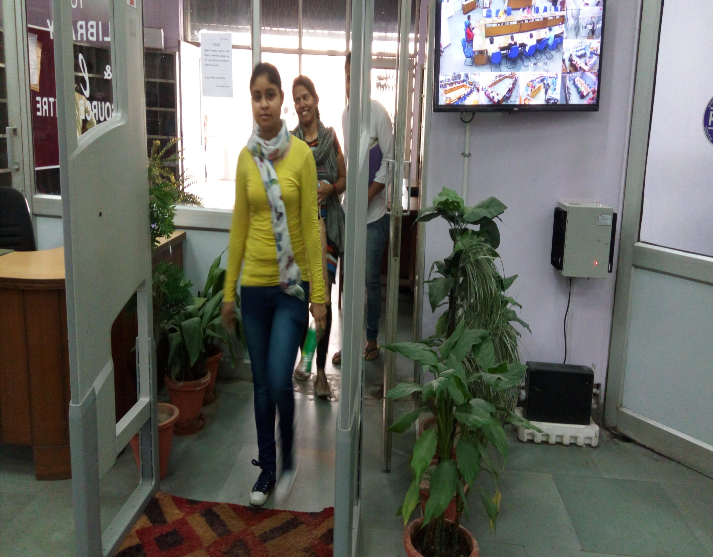

Slide 32
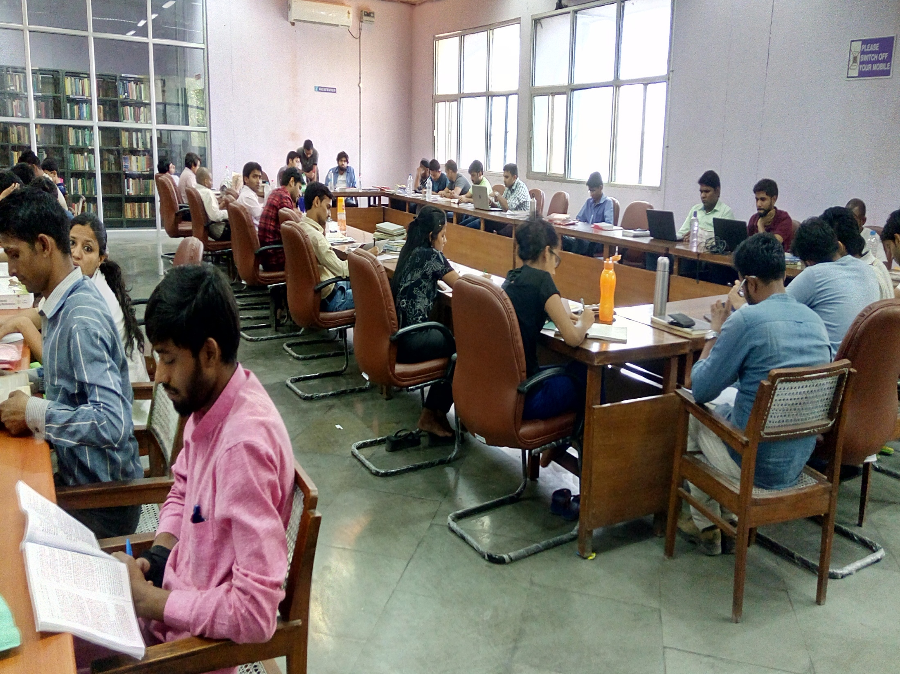

Slide 33
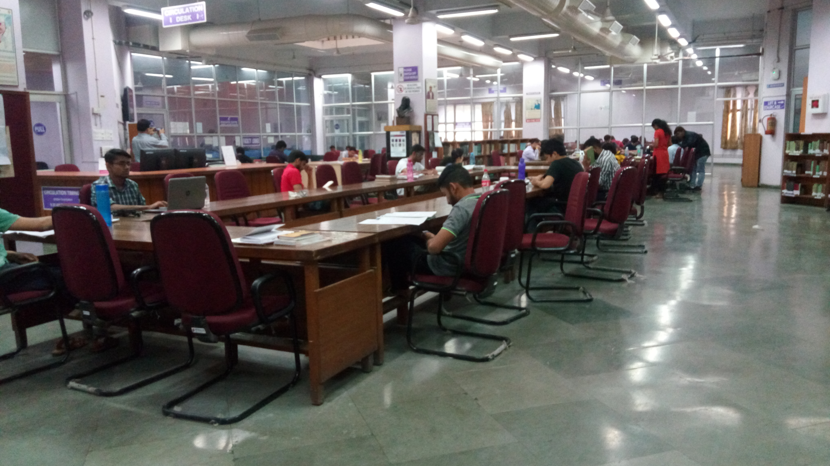
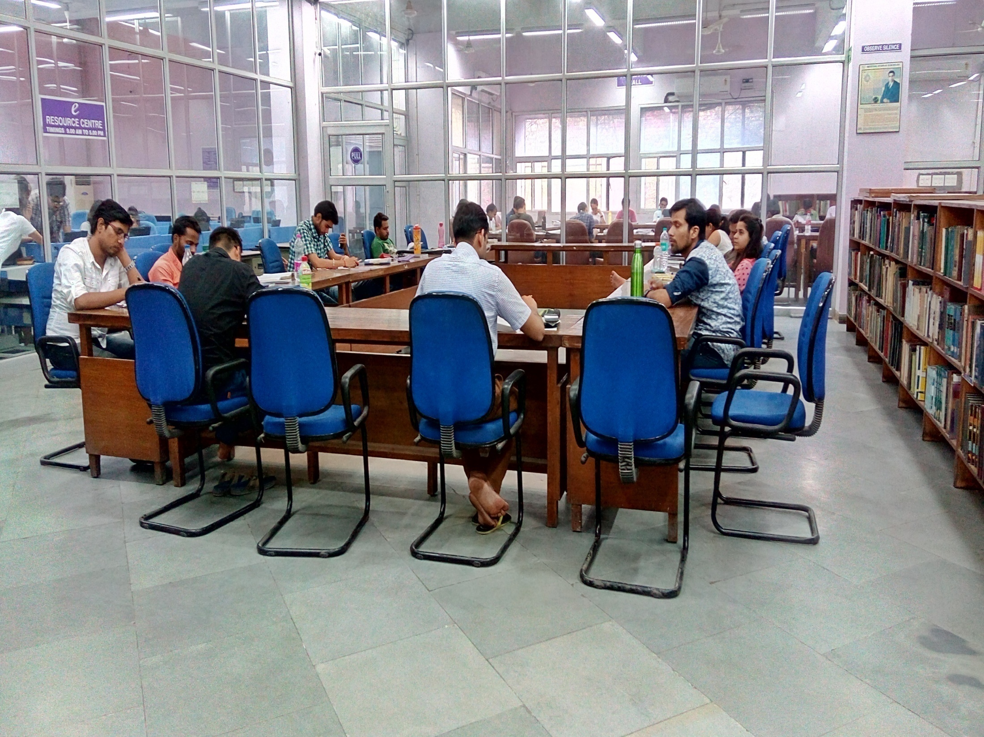

Slide 34
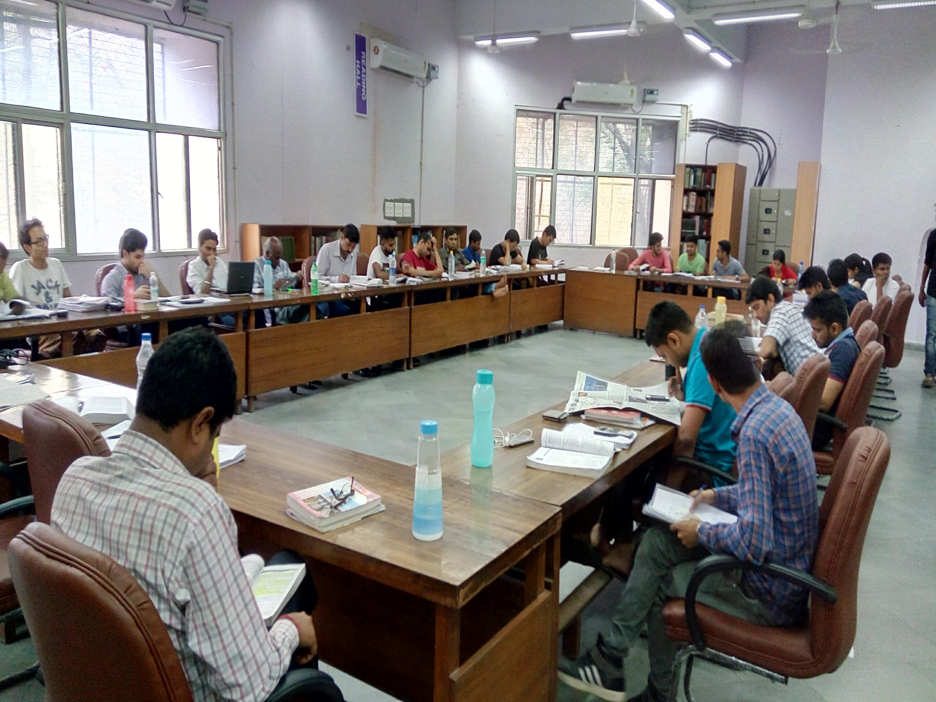

Slide 35
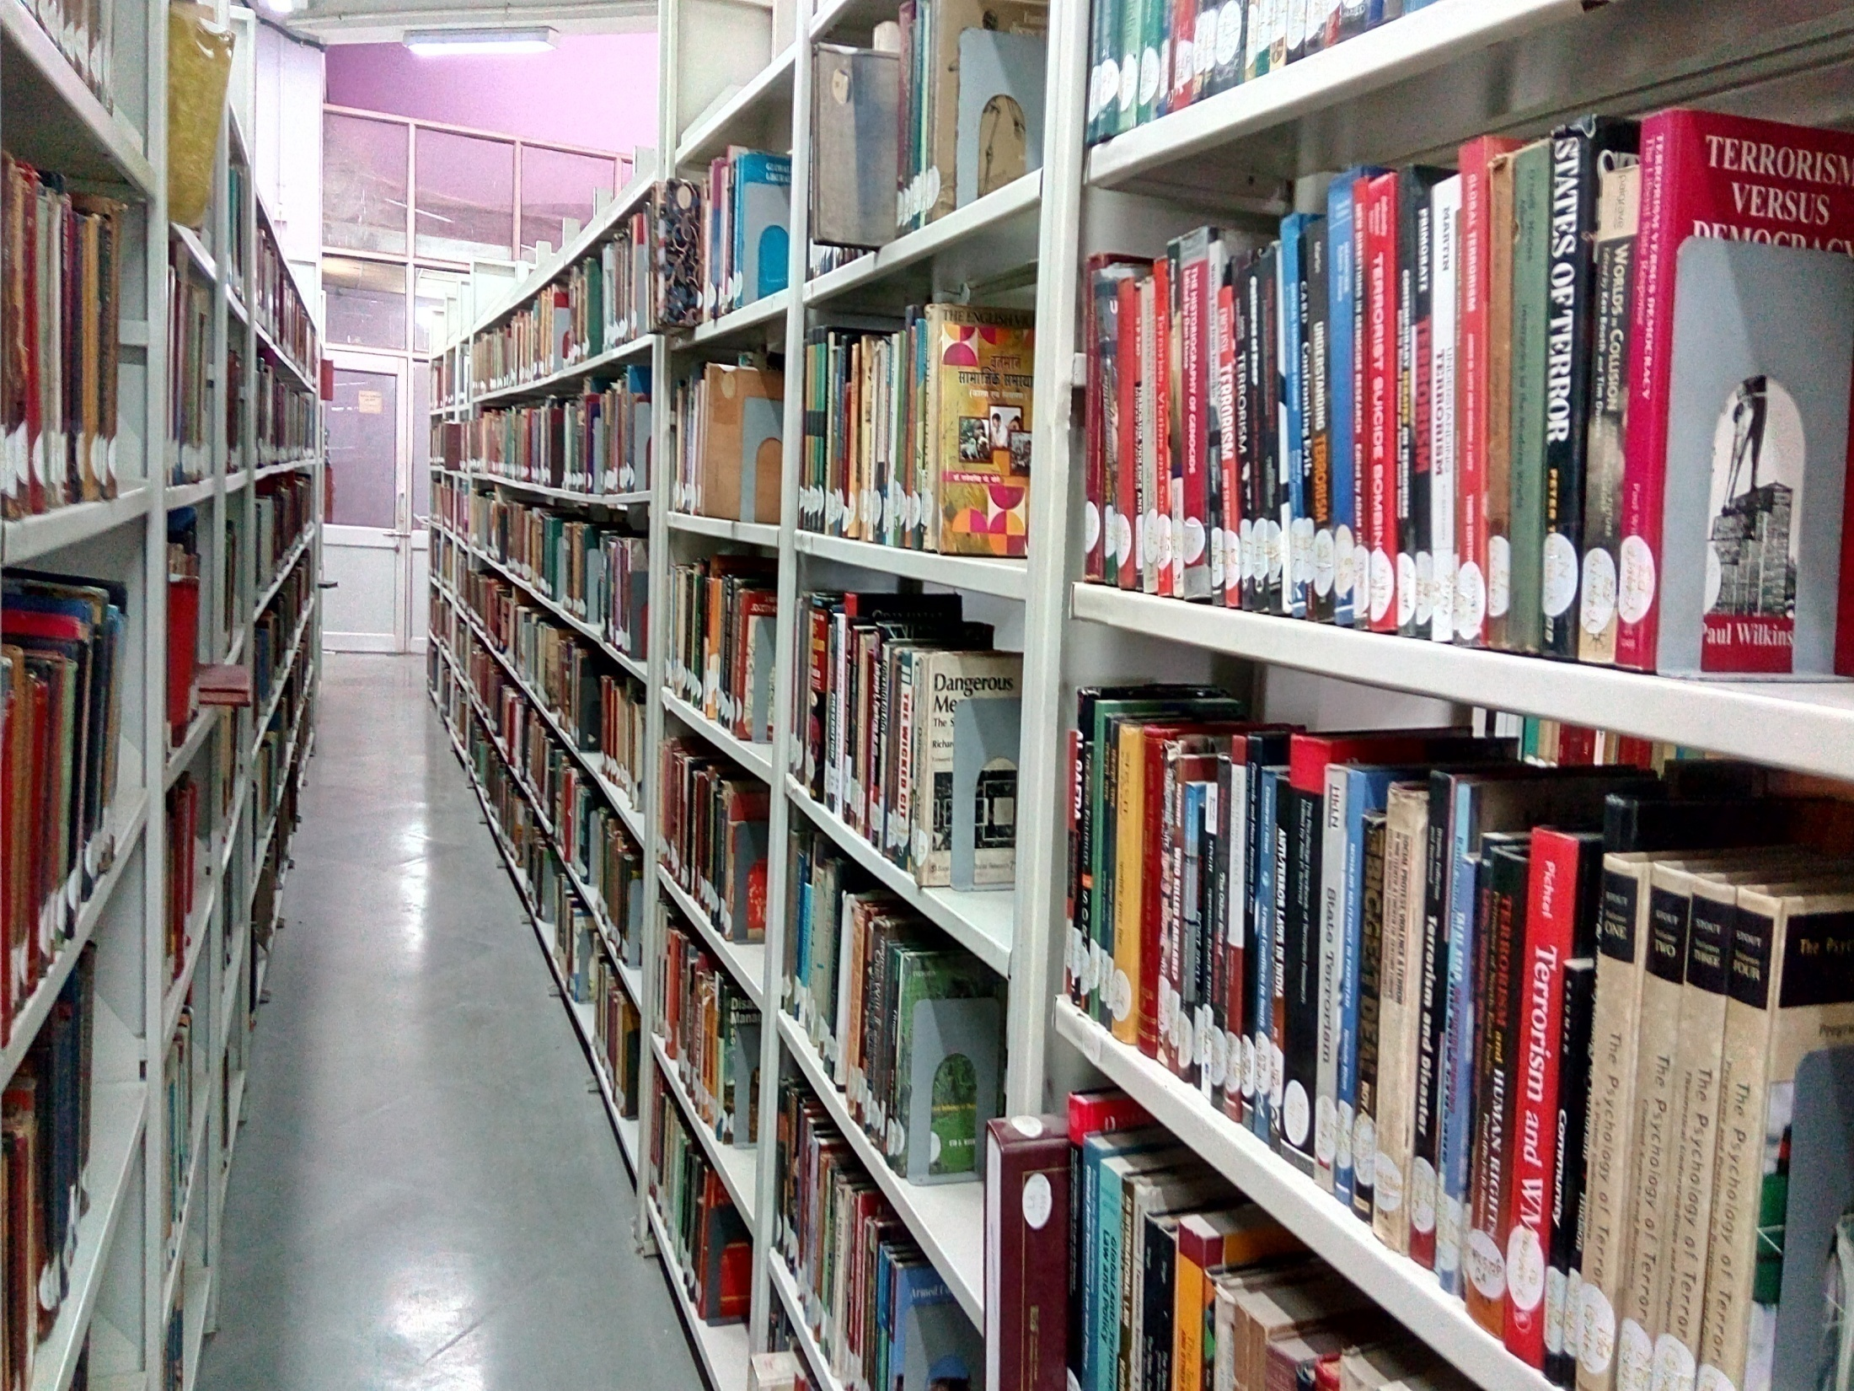
Human Resources:
Deputy Librarian - 01
Assistant Librarian - 01
Prof. Assistant – 02 (3 vacant)
Semi-Professional – 03 (2 vacant)
Assistant
Stenographer – 01
MTS – 12
Cleaner, Farash,
Machine Operator - 03
TOTAL - 23 ( 7 Vacant)

Slide 36
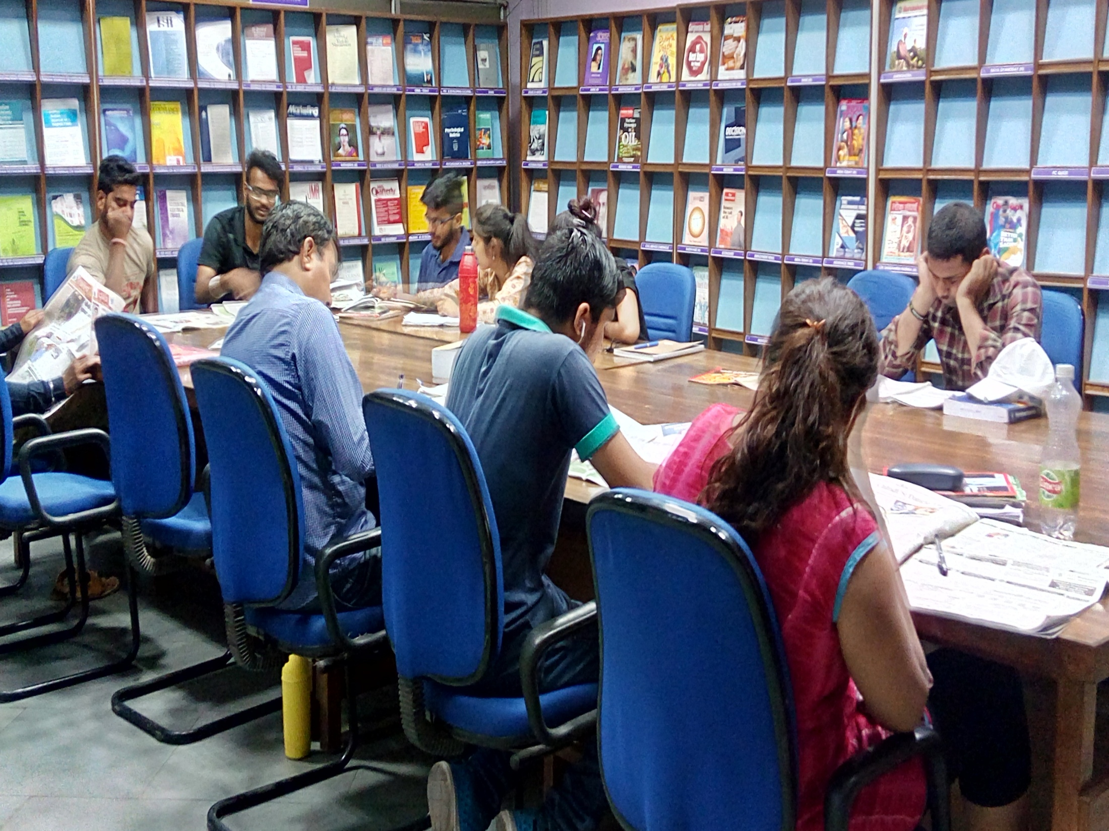

Slide 37
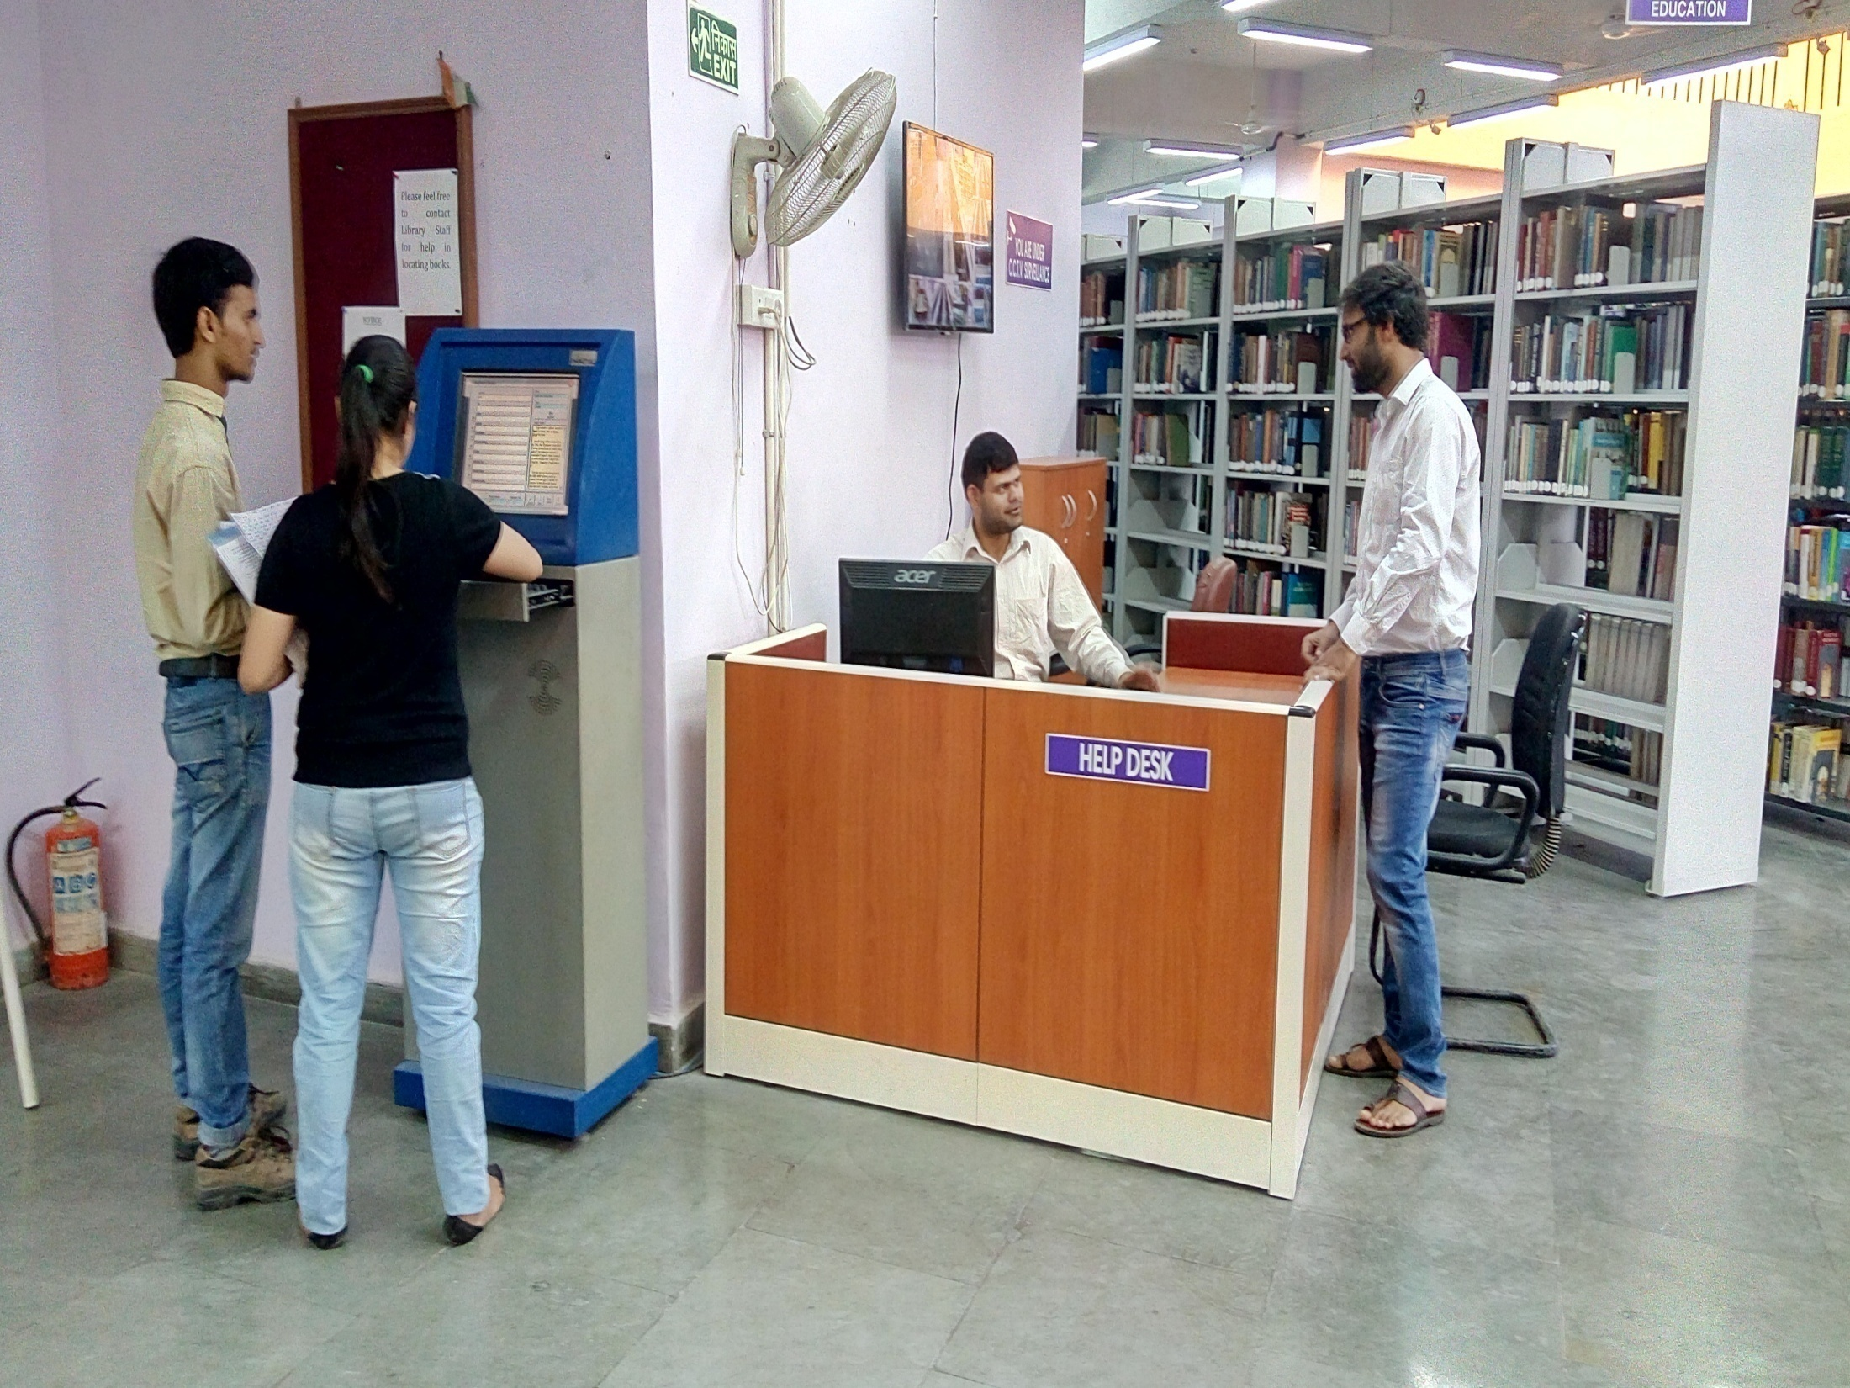

Slide 41
Human Resources:
Deputy Librarian - 01
Assistant Librarian - 01
Prof. Assistant – 02 (3 vacant)
Semi-Professional – 03 (2 vacant)
Assistant
Stenographer – 01
MTS – 12
Cleaner, Farash,
Machine Operator - 03
TOTAL - 23 ( 7 Vacant)

Slide 42
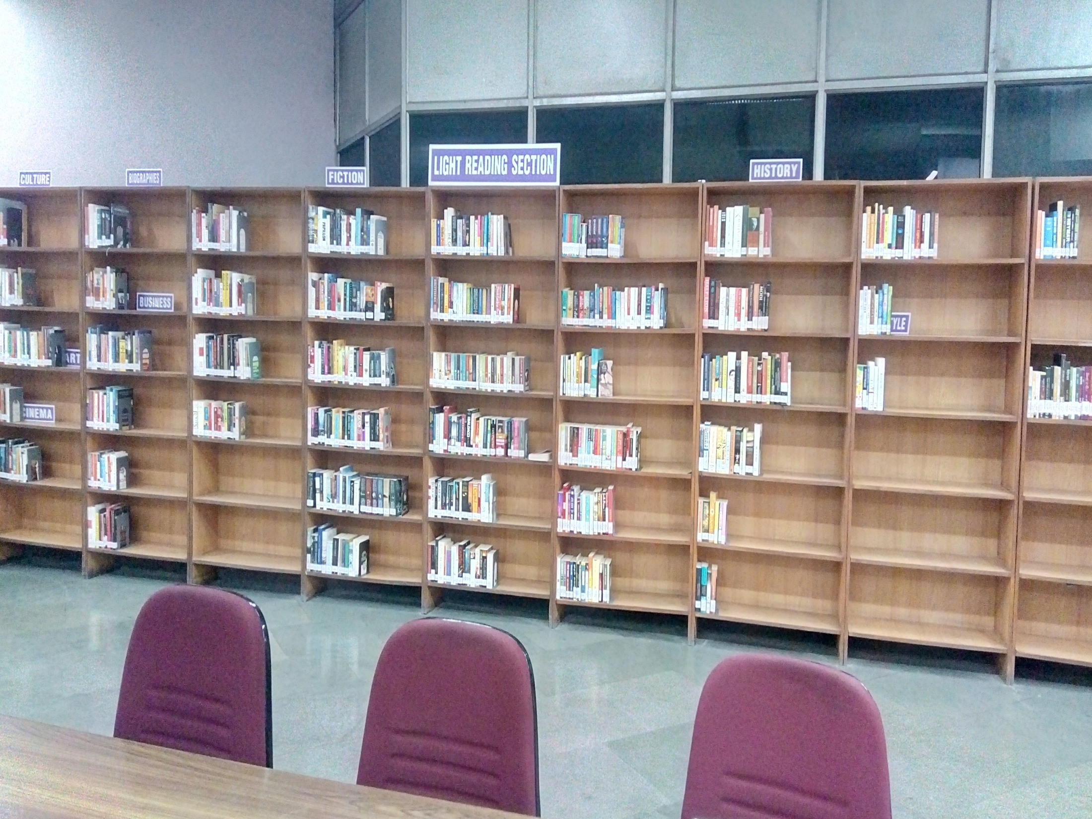

Slide 45
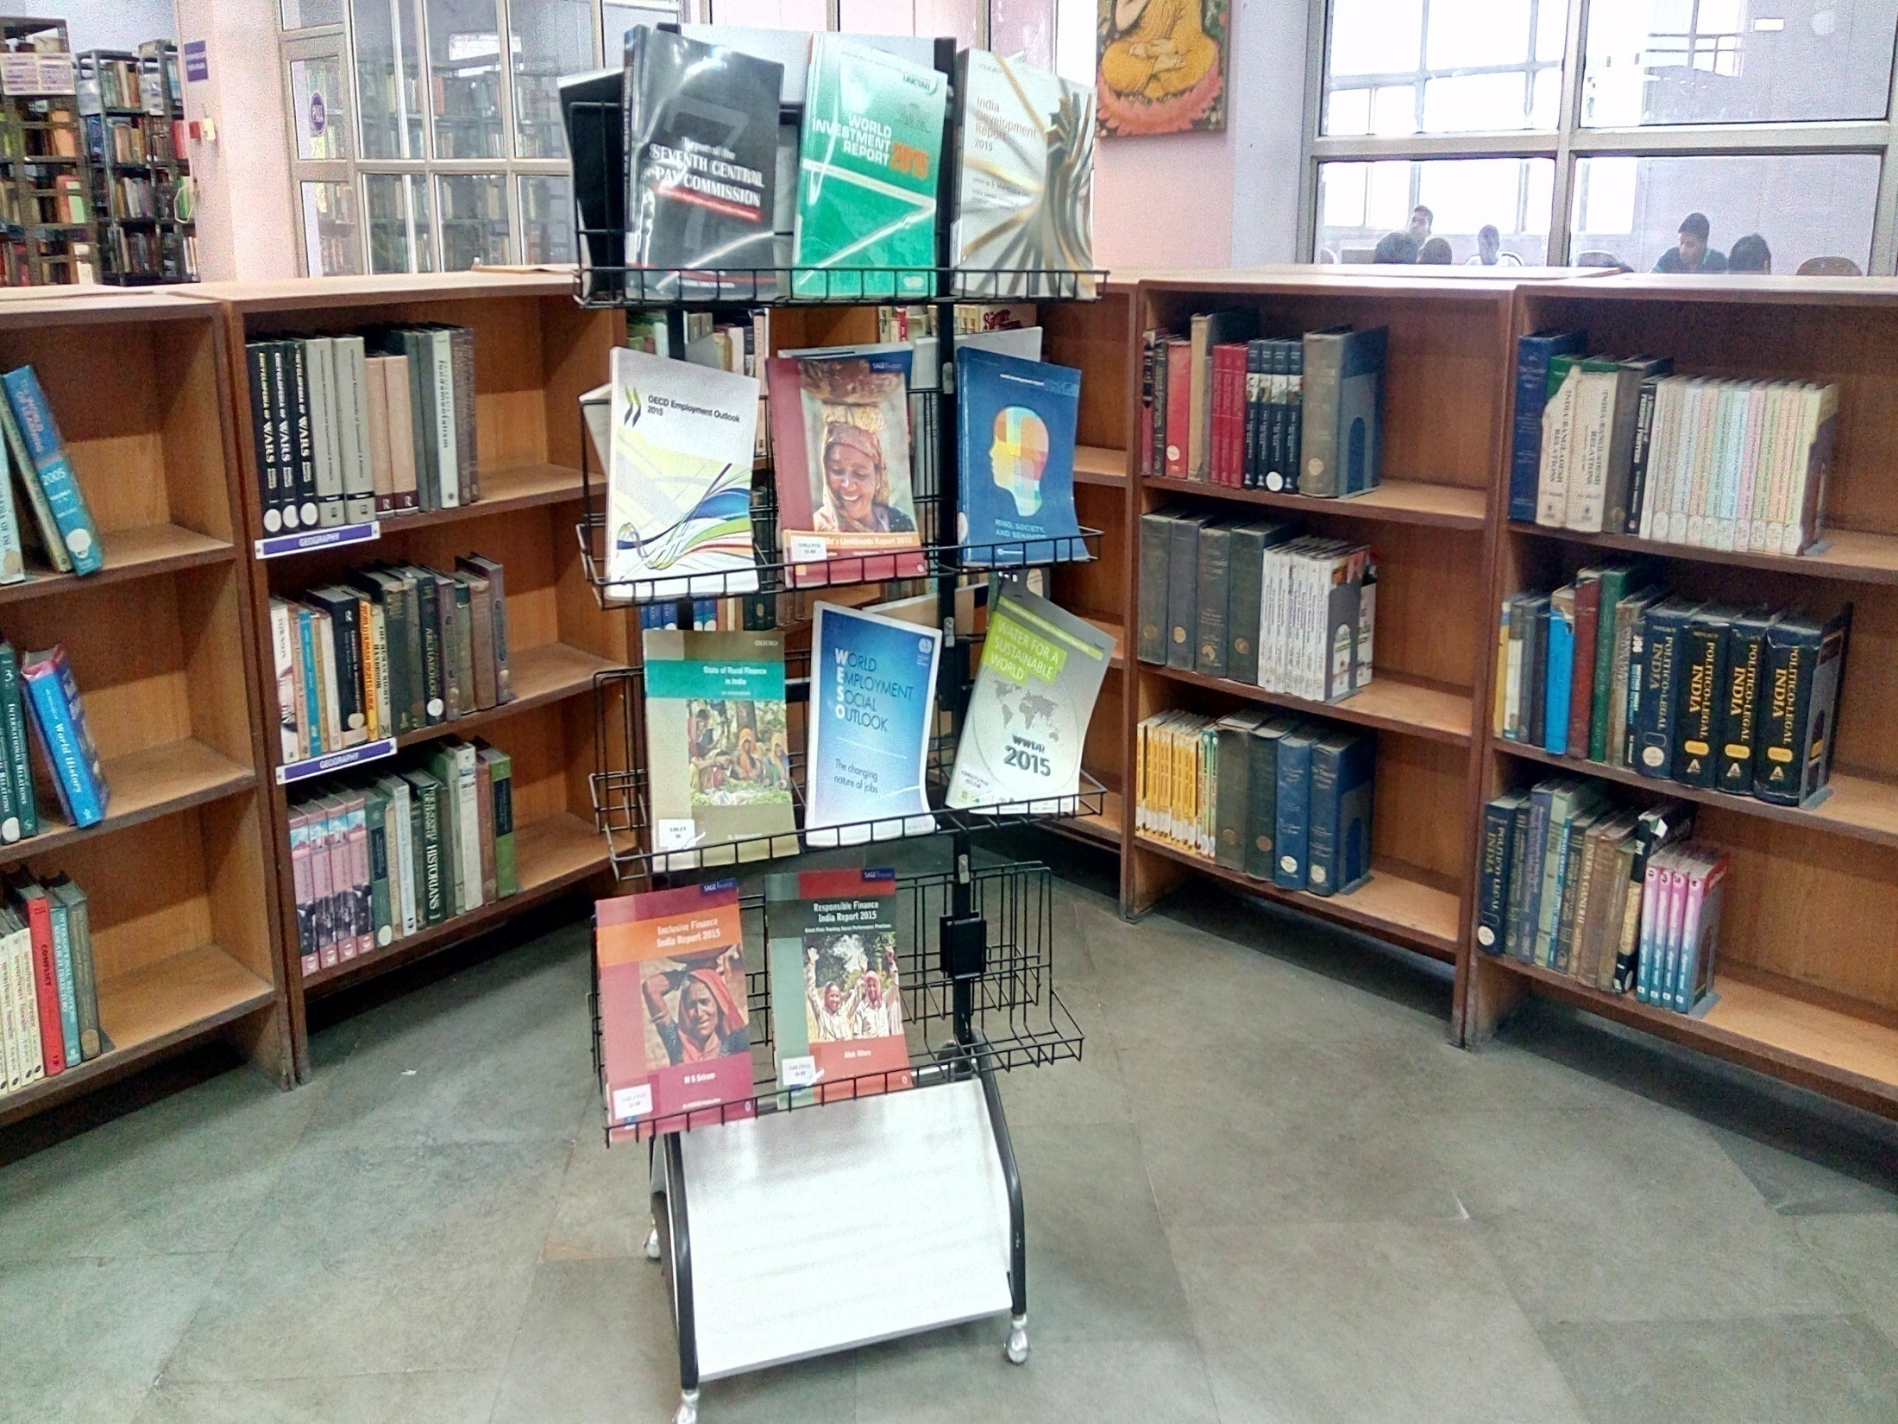

Slide 46
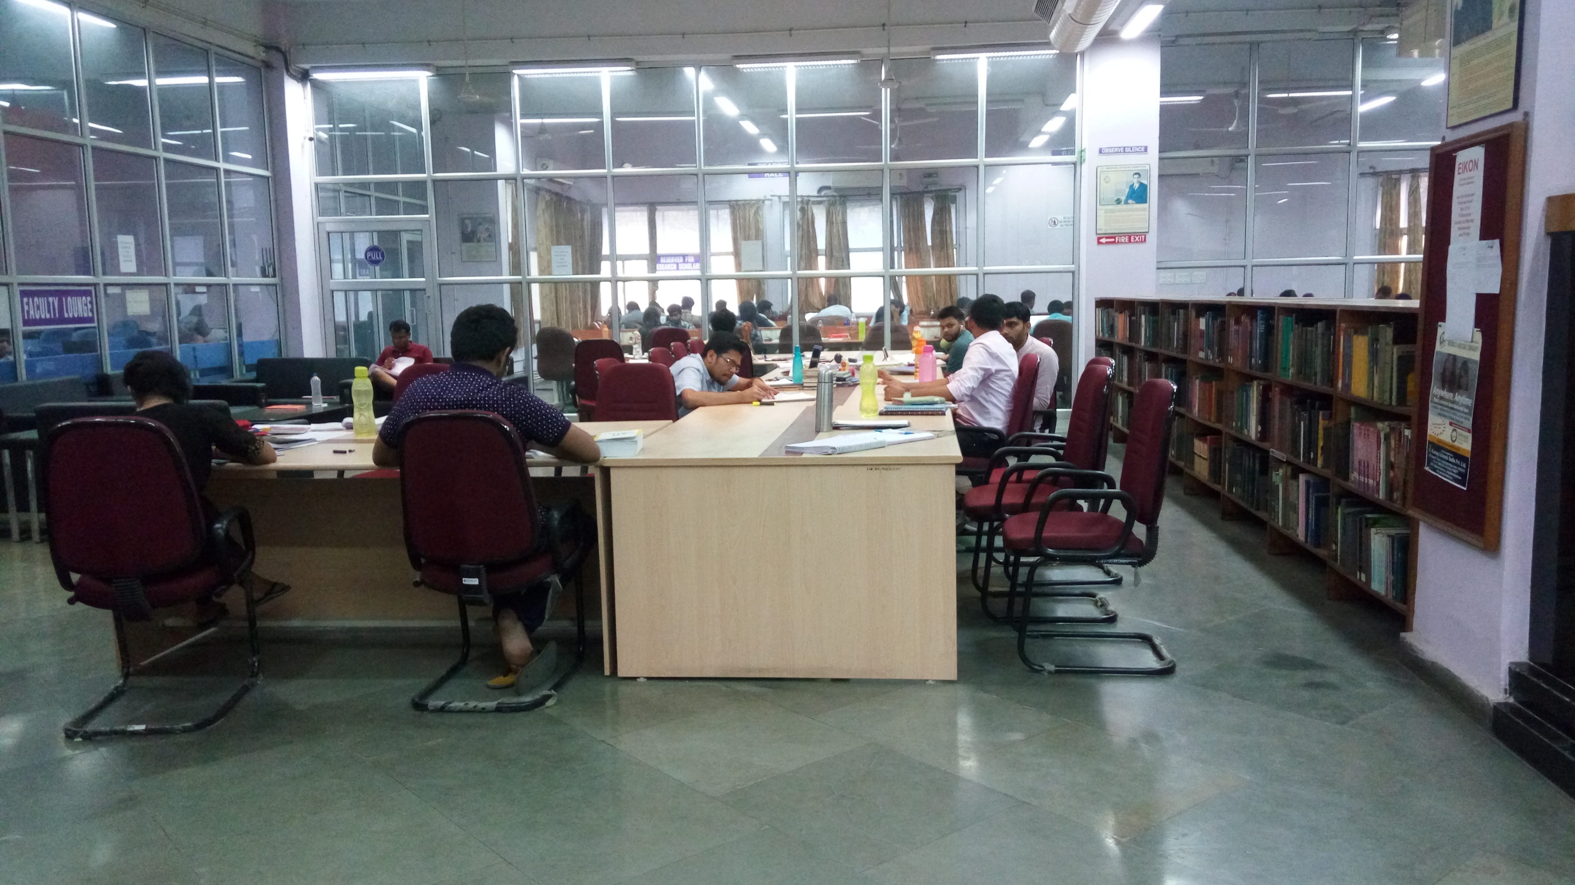
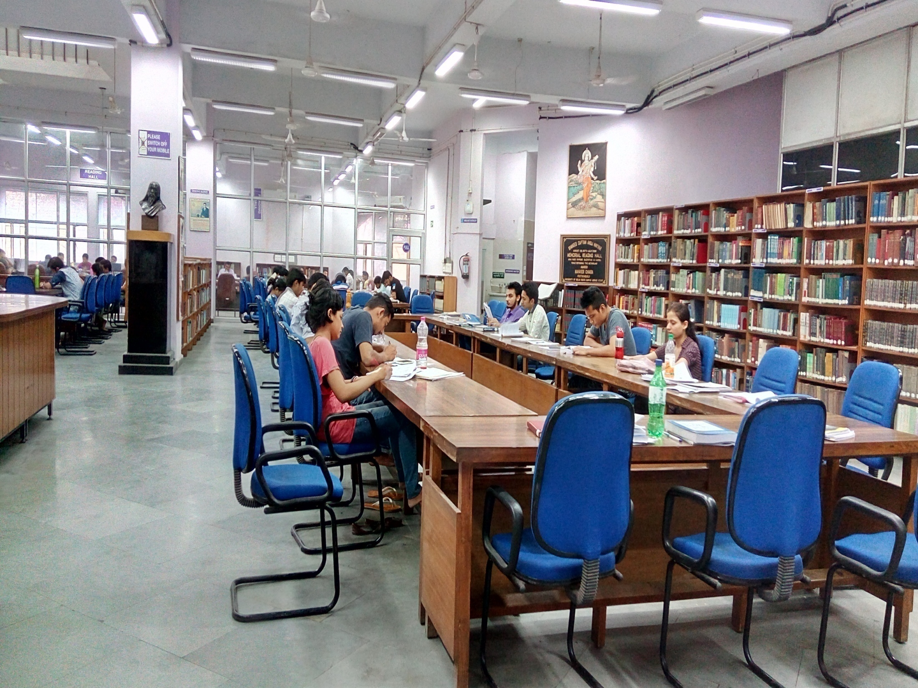

Slide 47
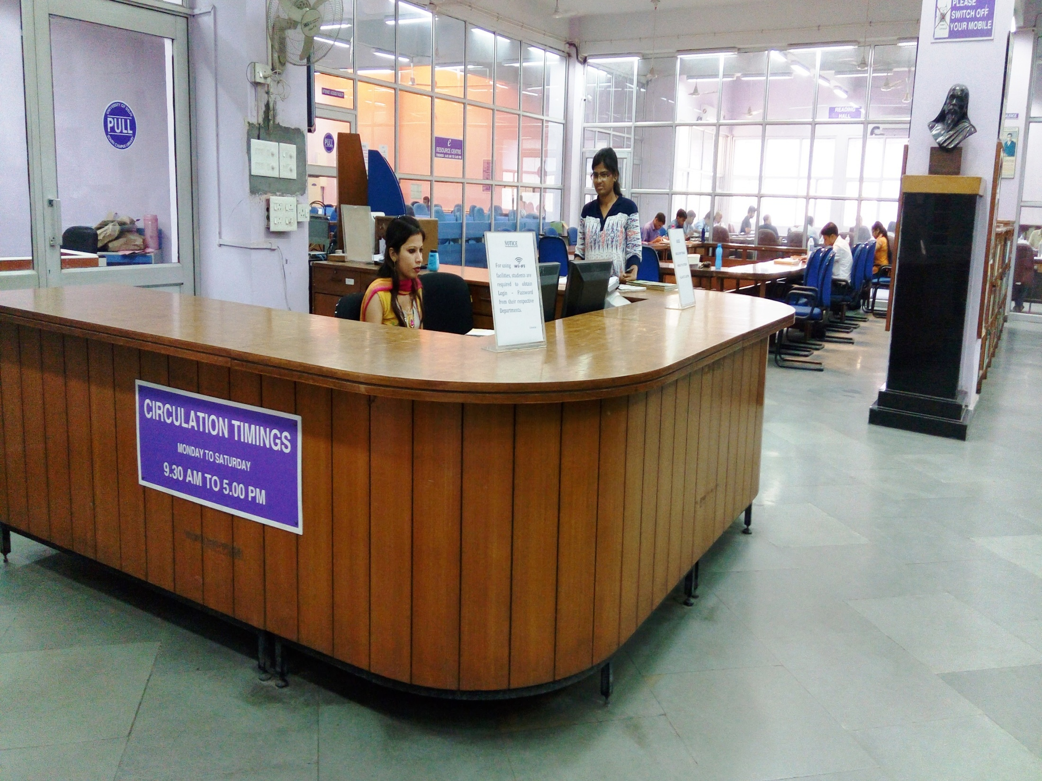

Slide 48
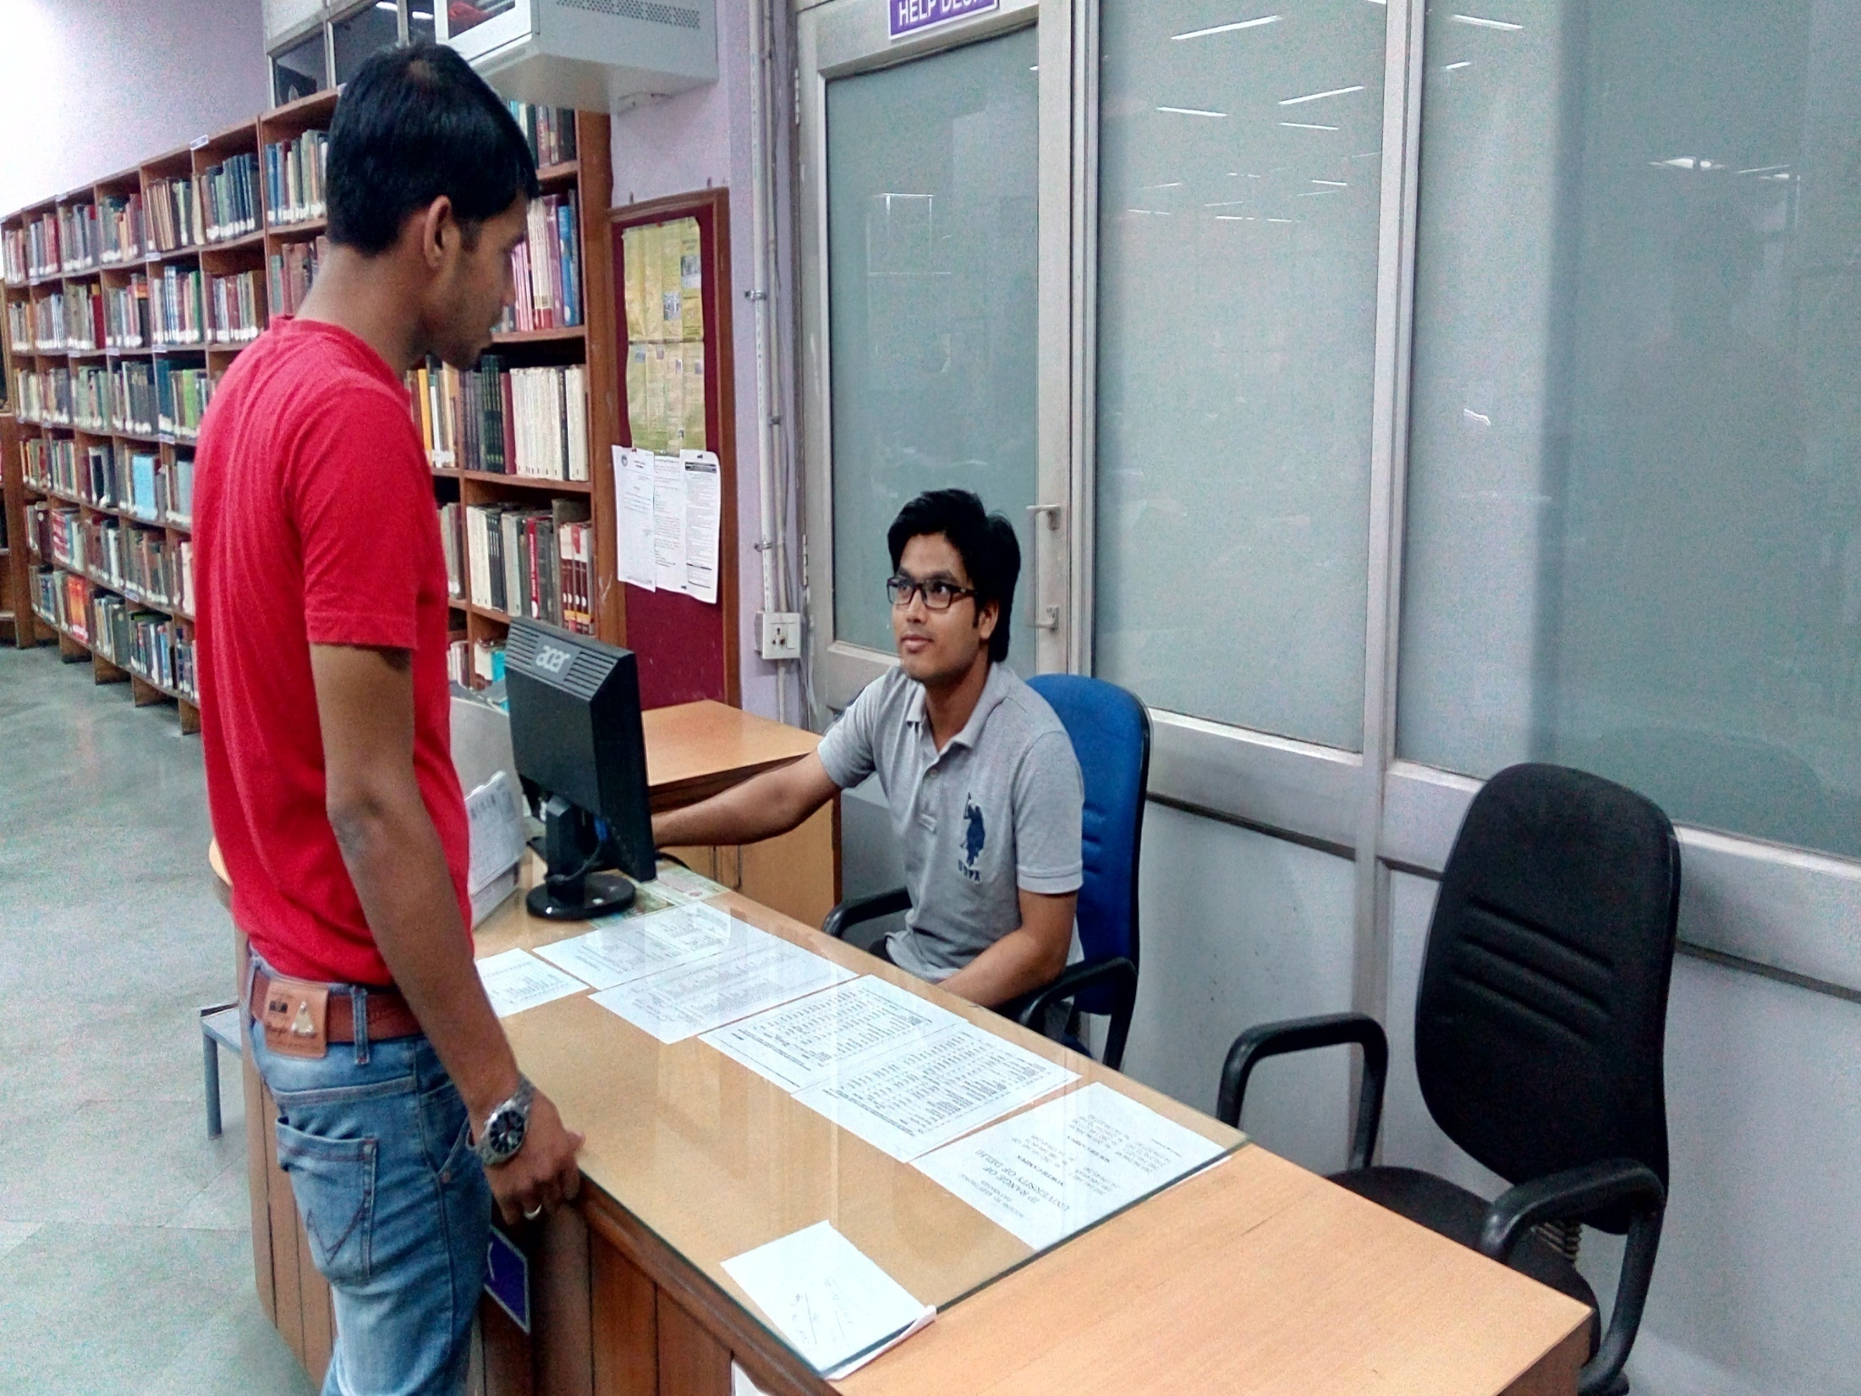

Slide 49
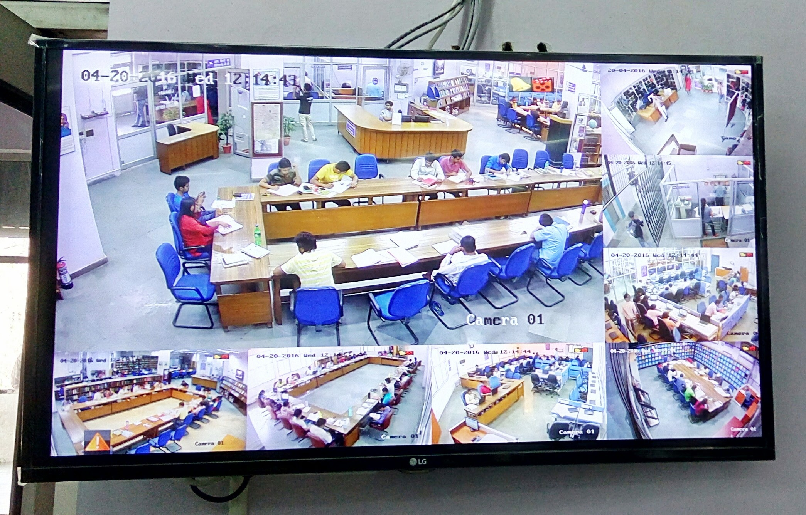

Slide 50
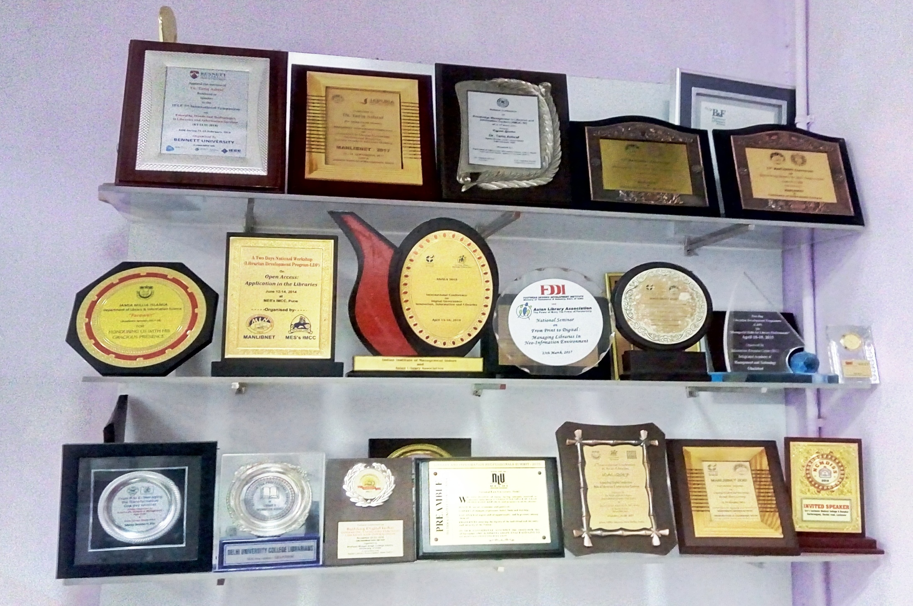
That’s it…Thank you for Patient Listening…

